Slide 1
Processes and threads - 2

Slide 2

Review
What is a process
  A program in execution
  Program (executable) – passive entity in the disk
  Process – active entity, includes program counter, stack and heap, text and data section
State diagram

Slide 3


Today we will discuss
Implementation of processes
Threads

Slide 4
Thinking
With the given process model, how can we realize an process in OS?
How can we make the OS support multiple programs running together?

Slide 5
Key problems
How to abstract a process
  The data structure of process
How to schedule a process
  Organization model (data structure)
  Scheduling actions (algorithms)

Slide 6
How to abstract a process
  Process – active entity, includes program counter, stack and heap, text and data section
  Main aspects related to the states
    What is the current state of a process?
      new, ready, running, waiting, or terminated?
    Which instruction to be executed?
    What data will be needed by the process?
    What information should be provided to select a ready process and let it running?
    Where can the CPU find necessary data and instructions in the memory?

Slide 7
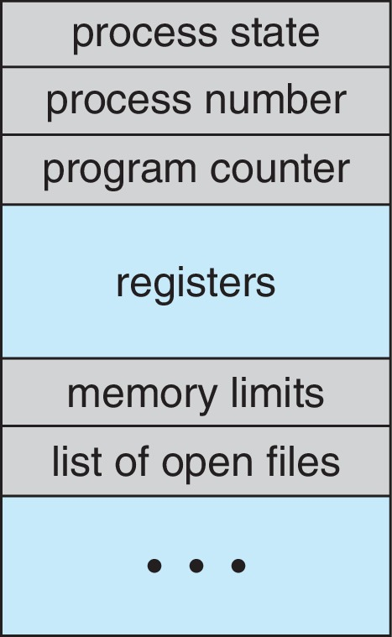
Process Control Block (PCB)
Information associated with each process
(also called task control block)
Process state – running, waiting, etc.
Program counter – location of instruction to next execute
CPU registers – contents of all process-centric registers
CPU scheduling information- priorities, scheduling queue pointers
Memory-management information – memory allocated to the process
I/O status information – I/O devices allocated to process, list of open files
Accounting information – CPU used, clock time elapsed since start, time limits
Execution
related info.
Data
related info.

Slide 8
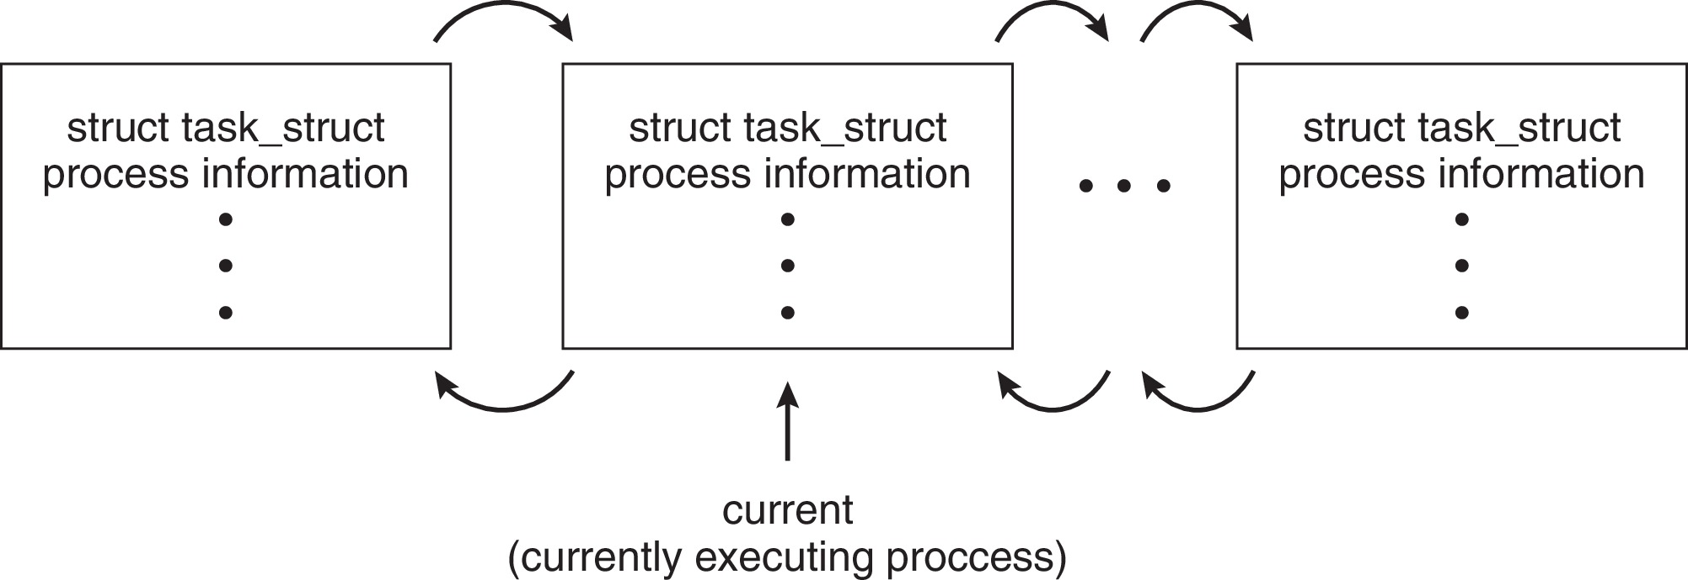
Process Representation in Linux
Represented by the C structure task_struct
pid t_pid; /* process identifier */
long state; /* state of the process */
unsigned int time_slice /* scheduling information */
struct task_struct *parent;/* this process’s parent */
struct list_head children; /* this process’s children */
struct files_struct *files;/* list of open files */
struct mm_struct *mm; /* address space of this process */

Slide 9
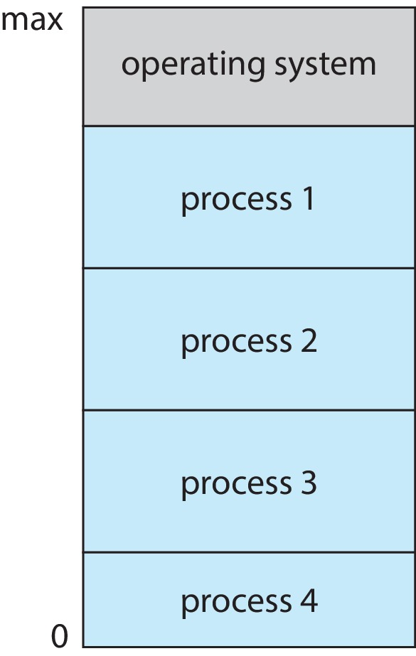
How to organize multiples processes
Multiprogramming (Batch system) needed for efficiency
  Single user cannot keep CPU and I/O devices busy at all times
  Multiprogramming organizes jobs (code and data) so CPU always has one to execute
  A subset of total jobs in system is kept in memory
  One job selected and run via job scheduling
  When it has to wait (for I/O for example), OS switches to another job

Slide 10

How to organize multiples processes
Questions
  How to classify processes in OS? How many kinds of processes in OS ?
  Which kind of data structure is suitable for organizing processes?

Slide 11
Process Organization Model
There are two sets of processes that related to scheduling, i.e. ready processes and waiting processes.
Queues are the best suitable data structure to represent such sets.
Maintains scheduling queues of processes
  Ready queue – set of all processes residing in main memory, ready and waiting to execute
  Wait queues – set of processes waiting for an event (i.e. I/O)
  Processes migrate among the various queues

Slide 12
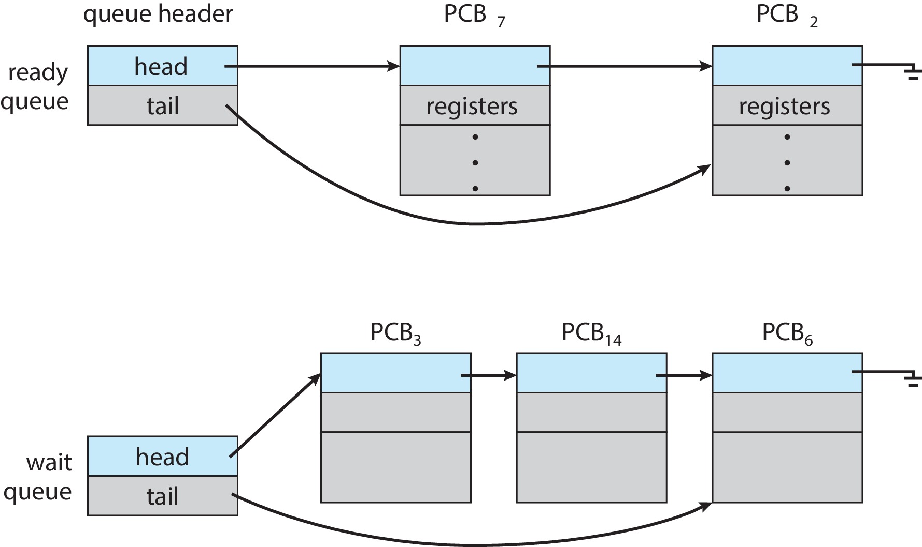
Ready and Wait Queues

Slide 13
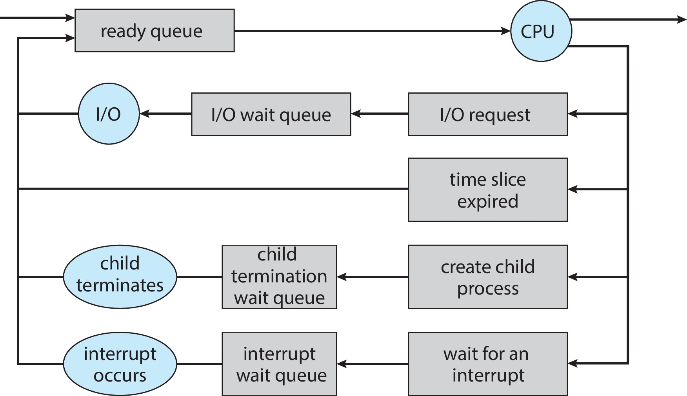
How to schedule the processes
Maximize CPU use, quickly switch processes onto CPU core
Process scheduler selects among available processes for next execution on CPU core
new
ready
running
job queue
terminated
waiting
Processes migrate between various queues during the OS executing.
waiting
waiting

Slide 14
Types of scheduling
Long-term scheduling (or job scheduling): selects a process to be brought into the ready queue.
  Controls degree of multiprogramming
  Tries to balance arrival and departure rate through an appropriate job mix.
  Less frequently (seconds or minutes) and may be slow
Short-term scheduling (or CPU scheduling): selects a process to be executed next and allocates CPU.
  More frequently (milliseconds) and must be fast
Interrupt handling: readies processes, moving them, for instance, from waiting to ready.

Slide 15

Types of scheduling
Medium-term scheduling: mixture of CPU and memory resource management.
  Key idea is swapping: remove a process from memory at one time and reintroduced it into memory at the other time to let it continue executing.
  Advantage: improve the process mix and adapt to available memory changing.

Slide 16
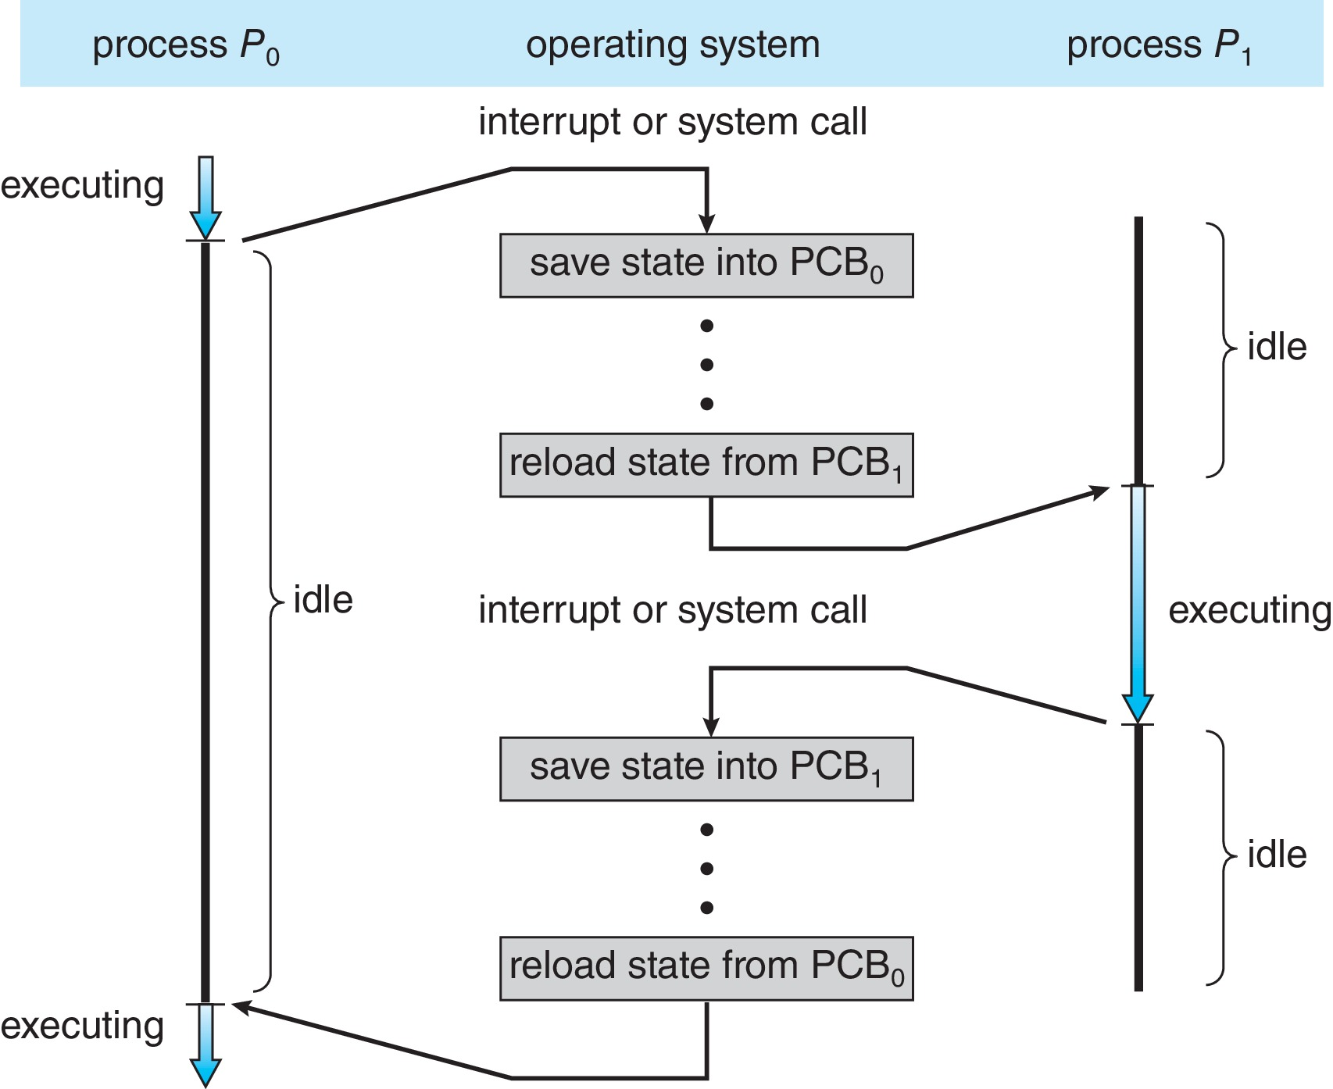
CPU Switch From Process to Process
When CPU switches to another process, the system must save the state of the old process and load the saved state for the new process via a context switch
CPU is switching from process P₀ to process P₁.

Slide 17
Context Switch
Context of a process represented in the PCB
Context-switch time is overhead; the system does no useful work while switching
  The more complex the OS and the PCB ➔ the longer the context switch
Time dependent on hardware support
  Some hardware provides multiple sets of registers per CPU ➔ multiple contexts loaded at once

Slide 18
Multitasking in Mobile Systems
Some mobile systems (e.g., early version of iOS) allow only one process to run, others suspended
Due to screen real estate, user interface limits iOS provides for a
  Single foreground process- controlled via user interface
  Multiple background processes– in memory, running, but not on the display, and with limits
  Limits include single, short task, receiving notification of events, specific long-running tasks like audio playback
Android runs foreground and background, with fewer limits
  Background process uses a service to perform tasks
  Service can keep running even if background process is suspended
  Service has no user interface, small memory use

Slide 19
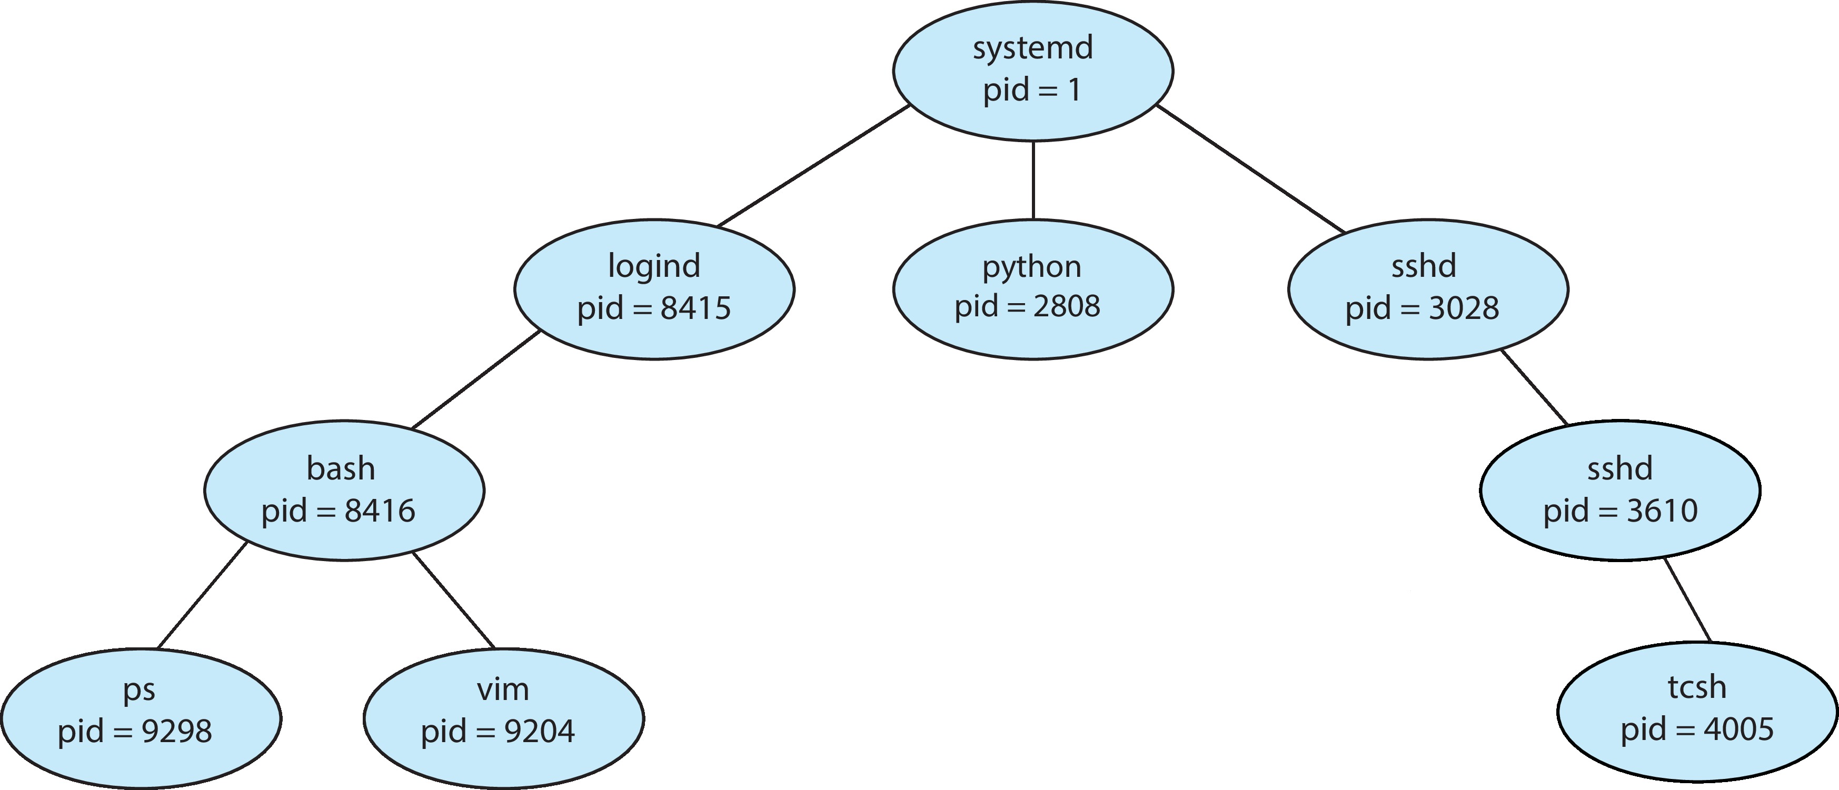
Operations on Processes
System must provide mechanisms for:
  process creation
    Parent process create children processes, which, in turn create other processes, forming a tree of processes
    Generally, process identified and managed via a process identifier (pid)
  process termination
A Tree of Processes in Linux

Slide 20
Operations on Processes
System must provide mechanisms for:
  process creation
  process termination
    Process executes last statement and then asks the os to delete it using the exit() system call.
      Returns status data from child to parent (via wait())
      Process’ resources are deallocated by os
    Parent may terminate the execution of children processes using the abort() system call. Some reasons for doing so:
      Child has exceeded allocated resources
      Task assigned to child is no longer required
      The parent is exiting and os does not allow a child to continue if its parent terminates

Slide 21
Relationships between parent and child
Resource sharing options
  Parent and children share all resources
  Children share subset of parent’s resources
  Parent and child share no resources
Execution options
  Parent and children execute concurrently
  Parent waits until children terminate
Address space
  Child duplicate of parent
  Child has a program loaded into it

Slide 22
Today we will discuss
Implementation of processes
Threads

Slide 23

Origin of threads
Group related resources together in the form of process to manage resources more easily.
Resource grouping
process
Executing
A process has a thread of execution, which is the entity scheduled for execution on the CPU.
Single-threaded process
Notes:
进程模型基于以下两个独立的概念：资源分组处理与执行。有时，这两个概念分开是有益的，这就是线程的由来。
观察进程的一种方式是，用某种方法把相关的资源集中在一起。进程有存放正文和数据以及其他资源的地址空间，把这些资源都放到进程中更易于管理。
另一个角度是，进程拥有一个执行的线程，拥有与调度相关的所有信息，是在CPU上被调度执行的实体。

Slide 24
Objectives
Identify the separate components of a process and illustrate how they are represented and scheduled in an operating system.
Describe how processes are created and terminated in an operating system, including developing programs using the appropriate system calls that perform these operations.
Describe and contrast interprocess communication using shared memory and message passing.
Design programs that uses pipes and POSIX shared memory to perform interprocess communication.
Describe client-server communication using sockets and remote procedure calls.
Design kernel modules that interact with the Linux operating system.

Slide 25
Processes and threads - 2

